Slide 1

Database – Project Suggest
AN. Le Quoc
DANG. Nguyen Cong

Slide 2
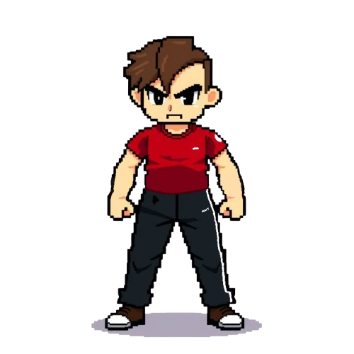
RPG Game
Context
Store & manage game data
Ensure consistency between player’s progress, NPC interactions and game logic.
Game balance adjustments and expansions (new items, quests, etc.)

Slide 3
RPG Game
Description
Gameplay mechanics
Core elements (Character stats, inventory, skills, progression, item upgrade, etc.)
Multiplayer functions (COMING SOON (maybe…))

Slide 4
RPG Game
Functions
Character | Class | Character save
General attributes (Name, Class, Level, HP, ATK, ...) to manage the character status Attribute Points for unique development – No character is the same | Usable items and skills for each class Class fuse – Choose your own path. | Save current player progress

Slide 5
RPG Game
Functions
Inventory | Item | Upgrade
Save the item quantity / durability that the player owns Remove items if player throws, sells or the item is broken Add items if player collects or buys from monsters, chests or shops on the go | Save all the information about items available in game | Shows the list of upgradeable items / upgraded items Inherit from item table to control the condition of the upgrade tools Save the upgrade recipe and rate

Slide 6
RPG Game
Functions
NPC | Monster | Boss
Give quests / rewards Buy / sell items | Have some general classes (Name, HP, ATK, ...) to manage the monsters attributes Level systems and mechanics to control monster's actions | Monster but stronger and more mechanics

Slide 7
RPG Game
Functions
Stage | Chest
Load the address of the map assigned for the stage Track the positions of objects on the map | Chest type & Rarity Obtainable Items & drop rate

Slide 8
RPG Game
Functions
Difficulties | Multiplayer (Will be available)

